Slide 1
Dimensional Modelling Steps

Slide 2
Design Strategy
Understand the relationship and type of data within the underlying RDBMS (Upstream data)
Identify the grain of data to be used.
Create De-Normalized Dimension tables.
Create Time Dimension Table
Create Fact tables having all foreign keys from dimension tables along with new derived columns which will further acts as measures.

Slide 3
Design Strategy
Use SSIS or any other ETL tool to perform ETL operation to load the dimension tables.
Use SSIS or any other ETL tool to load the fact table by adding derived columns for measures.
Show data through any Data Visualization tools such as Power BI

Slide 4
Phase 1
Understand the relationship and type of data within the underlying RDBMS (Upstream data)

Slide 5
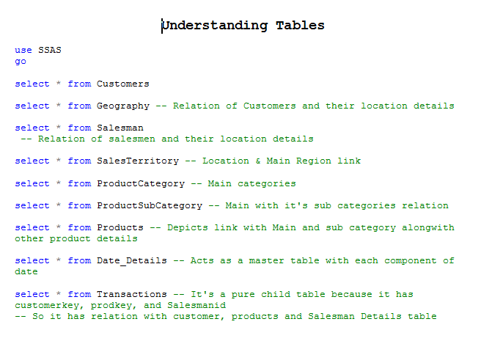

Slide 6
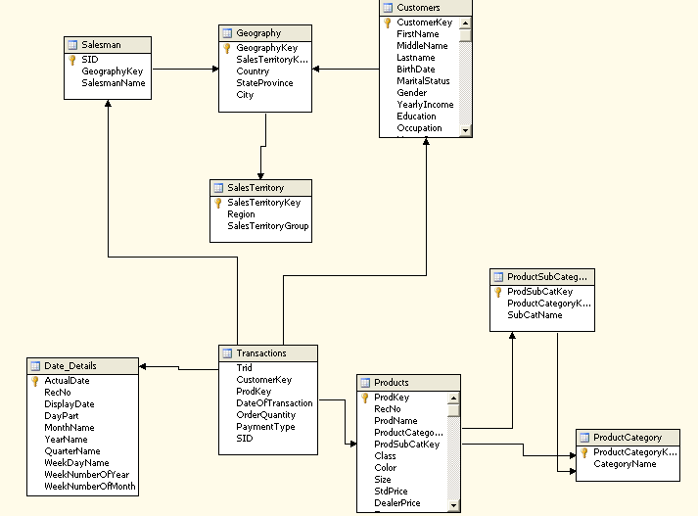
OLTP / RDBMS Tables

Slide 7
Phase 2
Create De-Normalized Dimension tables

Slide 8
Dim_Products Table
CREATE TABLE [dbo].[Dim_Products](
[ProductCategoryKey] [nvarchar](4) NULL,
[CategoryName] [nvarchar](25) NULL,
[ProdSubCatKey] [nvarchar](7) NULL,
[SubCatName] [nvarchar](35) NULL,
[ProdKey] [nvarchar](5) Constraint Dim_Product_Key Primary Key,
[RecNo] [int] NULL,
[ProdName] [nvarchar](35) NULL,
[Class] [nvarchar](10) NULL,
[Color] [nvarchar](15) NULL,
[Size] [nvarchar](10) NULL,
[StdPrice] [bigint] NULL,
[DealerPrice] [bigint] NULL,
[Tax] [numeric](22, 2) NULL,
[TotalPrice] [numeric](23, 2) NULL
) ON [PRIMARY]
GO

Slide 9
Dim_Customer table
CREATE TABLE [dbo].[Dim_Customer](
[CustomerKey] [nvarchar](10) Constraint Dim_Customer_Key Primary Key,
[FirstName] [nvarchar](50) NULL,
[MiddleName] [nvarchar](50) NULL,
[Lastname] [nvarchar](50) NULL,
[BirthDate] [date] NULL,
[MaritalStatus] [nvarchar](1) NULL,
[Gender] [nvarchar](1) NULL,
[YearlyIncome] [money] NULL,
[Education] [nvarchar](40) NULL,
[Occupation] [nvarchar](100) NULL,
[HouseOwnerFlag] [nvarchar](1) NULL,
[GeographyKey] [int] NULL,
[SalesTerritoryKey] [int] NULL,
[Region] [nvarchar](50) NULL,
[SalesTerritoryGroup] [nvarchar](50) NULL,
[Country] [nvarchar](50) NULL,
[StateProvince] [nvarchar](50) NULL,
[City] [nvarchar](30) NULL
) ON [PRIMARY]
GO

Slide 10
Dim_Salesman table
CREATE TABLE [dbo].[Dim_Salesman](
[SID] [nvarchar](12) Constraint Dim_Salesman_Key Primary Key,
[SalesmanName] [nvarchar](80) NULL,
[SalesTerritoryKey] [int] NULL,
[SalesTerritoryGroup] [nvarchar](50) NULL,
[GeographyKey] [int] NULL,
[Region] [nvarchar](50) NULL,
[Country] [nvarchar](50) NULL,
[StateProvince] [nvarchar](50) NULL,
[City] [nvarchar](30) NULL
) ON [PRIMARY]
GO

Slide 11
Phase 3
Create Time Dimension Table

Slide 12
Phase 4
Create Fact tables having all foreign keys from dimension tables along with new derived columns which will further acts as measures.

Slide 13
Fact_Transaction table
CREATE TABLE [dbo].[Fact_transaction](
[Trid] [bigint] NULL,
[CustomerKey] [nvarchar](10) NULL,
[ProdKey] [nvarchar](5) NULL,
[DateOfTransaction] [date] NULL,
[OrderQuantity] [int] NULL,
[PaymentType] [nvarchar](10) NULL,
[SID] [nvarchar](12) NULL,
[MonthName] [nvarchar](30) NULL,
[YearName] [nvarchar](30) NULL,
[QuarterName] [nvarchar](30) NULL,
[DayPart] [nvarchar](30) NULL,
[WeekDayName] [nvarchar](30) NULL,
[Class] [nvarchar](10) NULL,
[DealerPrice] [bigint] NULL,
[Tax] [numeric](22, 2) NULL,
[TotalPrice] [numeric](23, 2) NULL,
[StdPrice] [bigint] NULL,
[Customer_Type] [nvarchar](12) NULL,
[Quantity_Class] [nvarchar](2) NULL,
[Discount_PaymentType] [numeric](3, 2) NULL,
[Bill_Amount] [numeric](34, 2) NULL,
[Dealer_Comm] [bigint] NULL,
[WeekEndStatus] [nvarchar](3) NULL,
[WeekDayStatus] [nvarchar](3) NULL,
[FirstWeekStatus] [nvarchar](40) NULL,
[Service_Charge] [numeric](26, 4) NULL,
[After_Sales_Service_Charge] [numeric](23, 2) NULL,
[Salesman_Commission] [bigint] NULL,
[Branch_Commission] [numeric](24, 2) NULL
) ON [PRIMARY]

Slide 14
Add Foreign keys to Fact table
Alter Table Fact_transaction
Add Constraint FK_Cust_Key Foreign Key(CustomerKey) References Dim_Customer
go
Alter Table Fact_transaction
Add Constraint FK_Date_Key Foreign Key(DateOfTransaction) References Dim_Time
go
Alter Table Fact_transaction
Add Constraint FK_Salesman_Key Foreign Key(SID) References Dim_Salesman
go
Alter Table Fact_transaction
Add Constraint FK_Product_Key Foreign Key(ProdKey) References Dim_Products
go

Slide 15
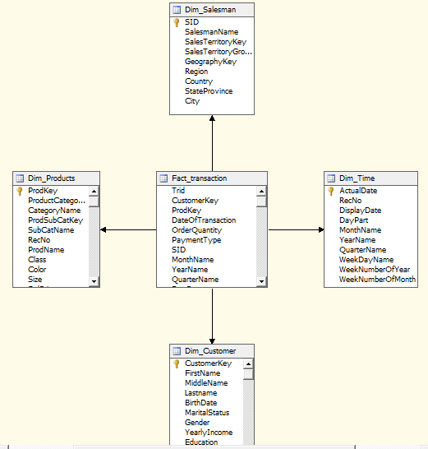
Dimensional Modelling

Slide 16
Phase 5
Using SSIS perform ETL operation to load the dimension tables.

Slide 17
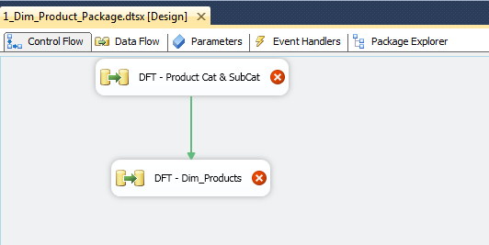
ETL to load Dim_Products table

Slide 18
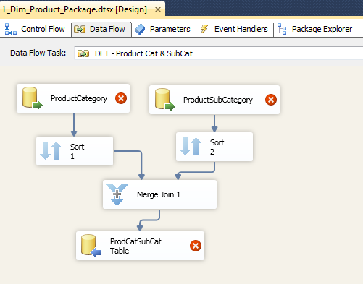
First DFT – Dim_Products

Slide 19
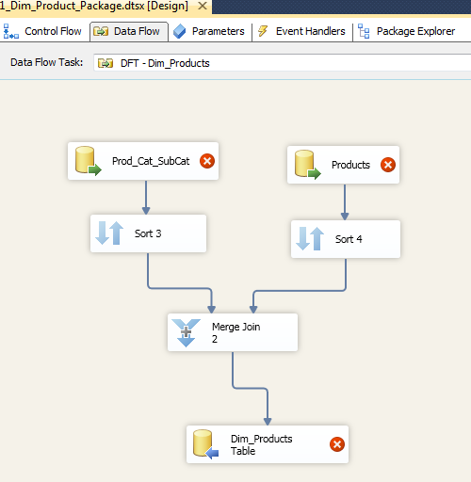
Second DFT

Slide 20
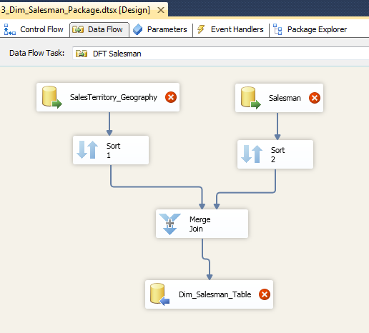
ETL to load Dim_Salesman table

Slide 21
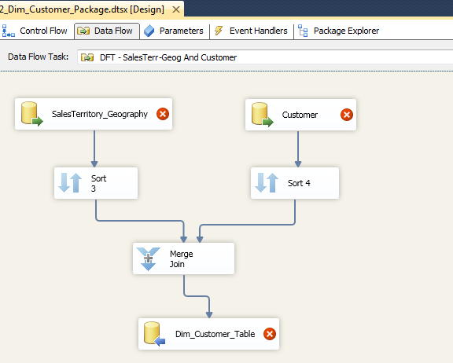
ETL to load Dim_Customers table

Slide 22
Phase 6
Using SSIS perform ETL operation to load the fact table by adding derived columns for measures.

Slide 23
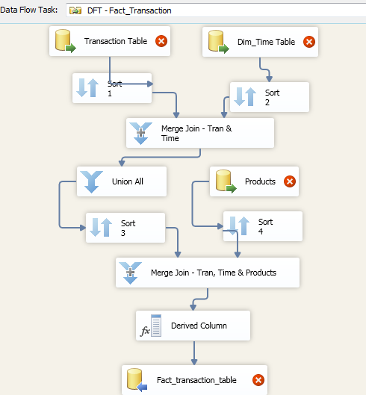

Slide 24
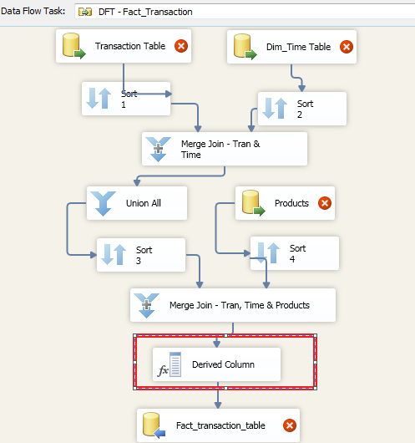

Slide 25
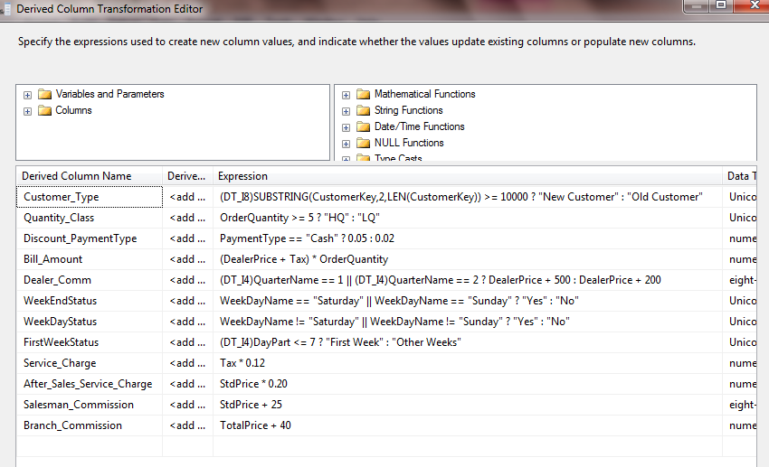
Derived Column Transformation for Fact table

Slide 26
Now all the dimension and fact tables are loaded.

Slide 27
Phase 7
Show data of the Dimensions and Fact tables using Power BI!!

Slide 28
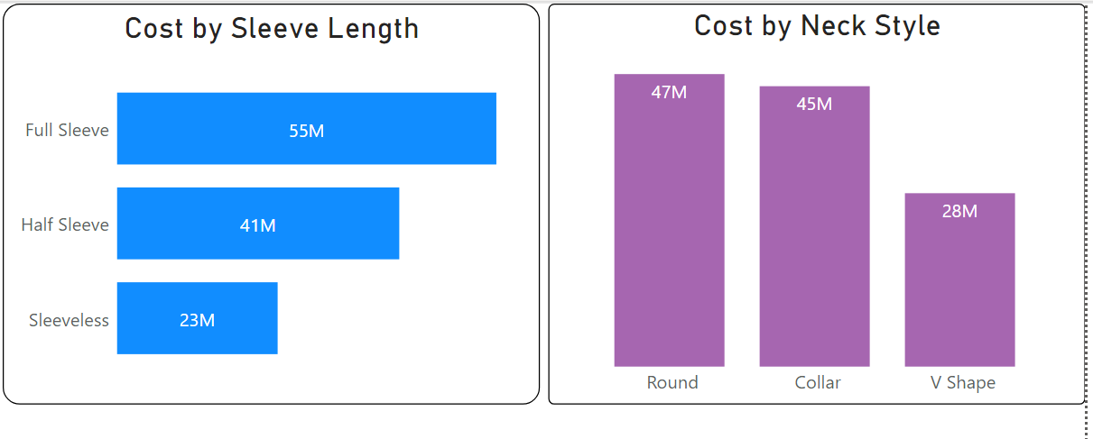
Data Visualization in Power BI – Part 1

Slide 29
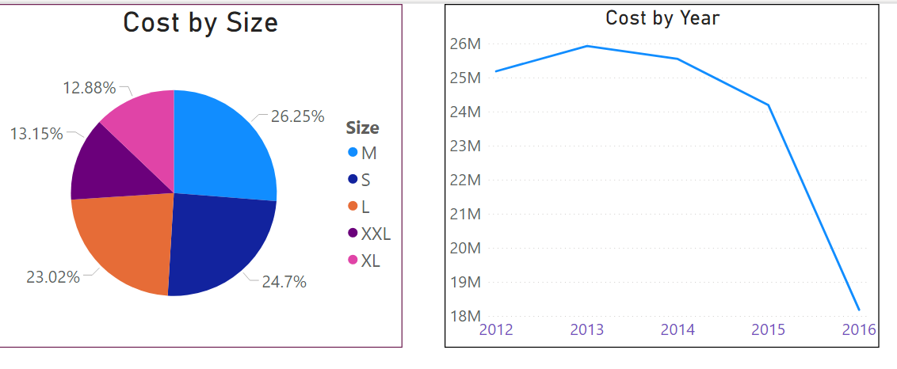
Data Visualization in Power BI – Part 2

Slide 30
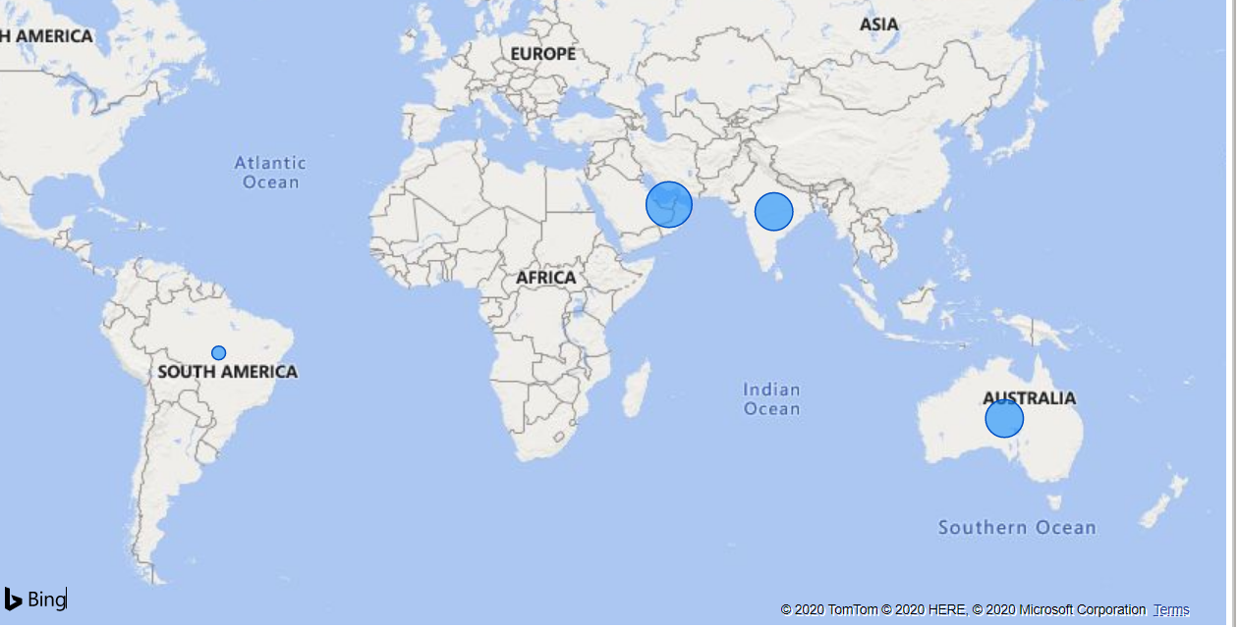
Data Visualization in Power BI – Part 3

Slide 31
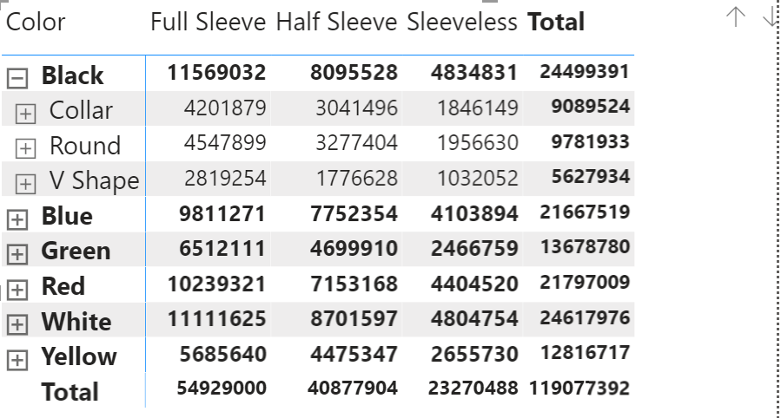
Data Visualization in Power BI – Part 4

Slide 32
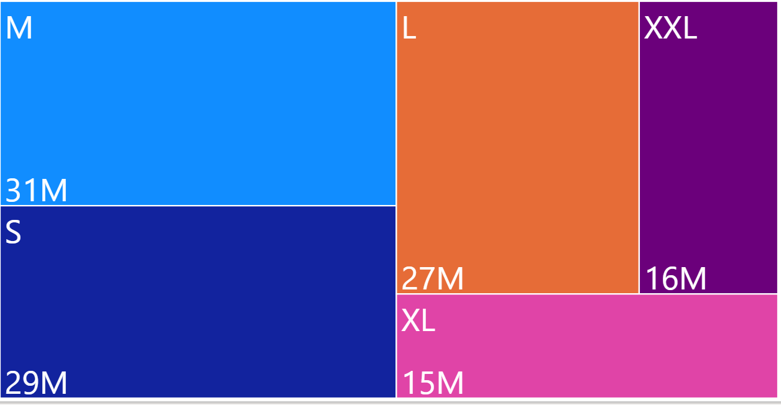
Data Visualization in Power BI – Part 5

Slide 33
Tools getting used for creating & populating dimension & fact tables
RDBMS Database -- SQL Server, Oracle, etc.
2) ERD tools – Erwin or any other.
3) ETL tool -- SSIS or any other to populate records in the dimension & fact tables.
4) Data Visualization tool – Power BI or any other.

